Slide 1

How many mobile phones in family homes?
Number of Phones in Home | Number of Homes | Total
0
1
2
3
4
5
6
7
8
9
10
Total number of mobiles
Notes:
Concept Introduction (30 mins):
“Hands-up” survey on Ownership of Electrical/ Electronic Items
Ask pupils to think about the number of mobiles (or other items) within their house, pupils should consider whether there are any in drawers/ cupboards, broken, etc.
Calculate the total number of phones within each home.

Slide 2

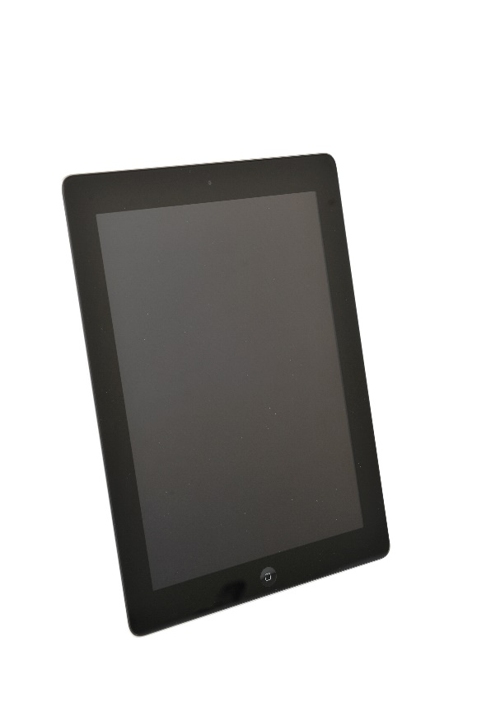
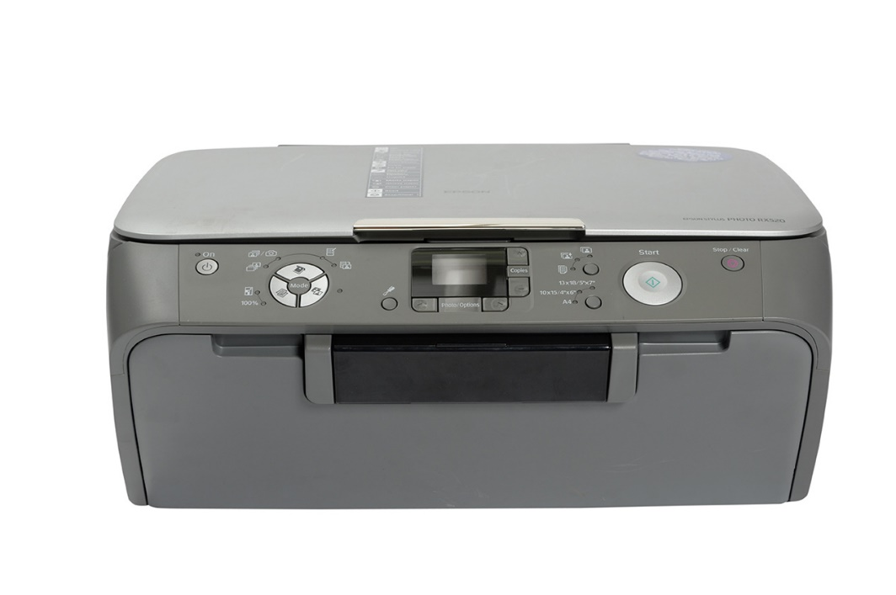

How many mobiles in the UK?
65 million phones
300,000 hoarded (not used)
Notes:
Pupils to guess how many mobiles are owned in the UK and to think about the amount of electrical/ electronic items that they own in their home.
Follow-on activity, could include pupils imagining what their life would be like without electrical/ electronic equipment.

Slide 3
Speaker
Diagram adapted from Fairphone website
Earpiece
Screen
Capacitors
Screen PCB
Chips
Flexible PCB
Sim card slot
Component connectors
Vibrating mechanism
Printed Circuit Board
Buttons
Battery connector
Notes:
Level 1/ Introductory Activity ( 1hr): What’s inside a tablet
Description of items within a typical tablet. If your school has requested the resource pack, there is a framed tablet that has been broken apart to show the various components. Pupils can try to identify as many components as possible.

Slide 4

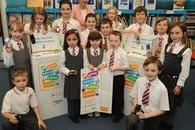

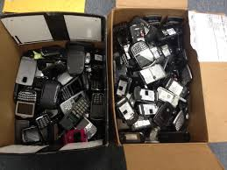
What can you do to help?
Notes:
Pupils could set up a collection scheme within their school, design posters and run a campaign and let people know what to do with electrical/ electronic items that they no longer need.

Slide 5

Why should we collect Electrical & Electronic Equipment?
Prevent waste
Help people
Save the environment
Make money for schools

